Slide 1

Organizational Behavior
(MGT-502)
Lecture-32

Slide 2
Summary of
Lecture-31

Slide 3
Elements of Organizational Structure
Department-
alization
Span of
Control
Organizational
Structure
Elements
Formalization
Centralization

Slide 4
Common Organizational Design
Simple Structure
Bureaucracy
Matrix Structure

Slide 5
The Distinguishing Feature of Job Design in the Future
Flexibility

Slide 6
Evolving Forms of
Organizational Design
Several new forms of organizational design
  Self-managing teams
  Team-based approach
  The virtual organization

Slide 7
Today’s Topics

Slide 8
Four Symptoms of Structural Weakness
Delay in decision
making
Poor quality
decision making
Lack of innovative
response to changing
environment
High level of
conflict
Overloaded hierarchy; information
funneling limited to too few channels
Right information not reaching
right people in right format
No coordinating effort
Departments work against each
other, not for organizational goals

Slide 9
Organizational Strategy
Mission
What we are or want to be?
Specific Goals
What must be achieved? When?
Strategy
What will we do to get there?

Slide 10
Environmental Factors
Environmental Uncertainty
  Exists when managers have little information about environmental events and their impact on the organization.
  When the organizational environment is complex and dynamic, the manager may have little information about future events and have great difficulty predicting them.

Slide 11
Environmental Factors
Environmental Complexity
  The number of environmental components that effects on organizational decision making.
Environmental Dynamism
  The degree to which these components change.

Slide 12
Elements of the Environment
Technology
Political/Legal
The Organization
Sociocultural
Economic

Slide 13
Org. Environment & Structure
Dynamic
Stable
• High rate of change
• Use organic structure
• Steady conditions, predictable change
• Use mechanistic structure
Complex
Simple
• Many elements (such as stakeholders)
• Decentralize
• Few environmental elements
• Less need to decentralize

Slide 14
Org. Environment & Structure (con’t)
Diverse
Integrated
• Variety of products, clients, locations
• Divisional form aligned with the diversity
• Single product, client, location
• Don’t need divisional form
Hostile
Munificent
• Competition and resource scarcity
• Use organic structure for responsiveness
• Plenty of resources and product demand
• Less need for organic structure

Slide 15
Technology
The Electronic Revolution - Web-based and other technologies have allowed companies to take a new look at their structures.
The trend is to use more organic forms that support flexibility.

Slide 16
Technology
Early focus - Production processes
Later focus - Knowledge technology
  Task Variability
  Problem Analyzability

Slide 17
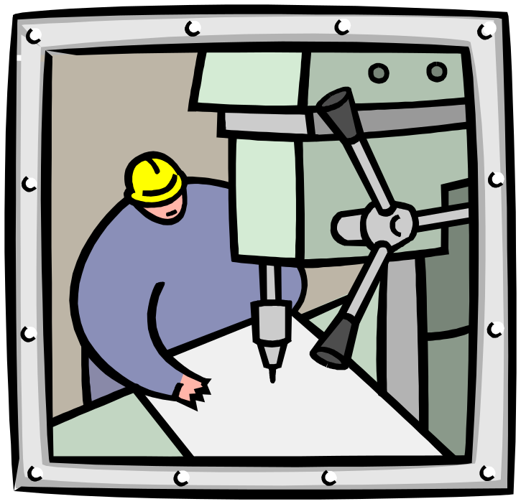
Work Design and Technology

Slide 18
Technology in the Workplace
Continuous Improvement Processes
  Good isn’t good enough
  Focus is on constantly reducing the variability in the organizational processes to produce more uniform products and services.
    Lowers costs and raises quality.
    Increases customer satisfaction.
  Organizational impact
    Additional stress on employees to constantly excel.
    Requires constant change in organization.

Slide 19
Key Elements:
Identifying an organization’s distinctive competencies.
Assessing core processes.
Reorganizing processes.

Slide 20
Process Reengineering
Rethinking and redesigning the processes by which the organization creates value and does work, ridding itself of operations that have become antiquated.

Slide 21
Downsizing and Rightsizing
Downsizing (rightsizing) involves reducing the size of the organization by selling off or closing down units or product lines to increase profitability.
Probably will call for a change in structure.

Slide 22
Mergers and Acquisitions
The search for competitiveness may call for the joining of two or more firms through M & A.
The challenge for these firms is to find a structure that works for the combined entity.

Slide 23

Learning Organization
Learning Organization proactively creates, acquires, and transfers knowledge throughout the organization

Slide 24

What’s an e-Organization?
A profit or nonprofit organization that uses the Internet and private network links to facilitate activities and communication

Slide 25
Electronic Commerce

Slide 26

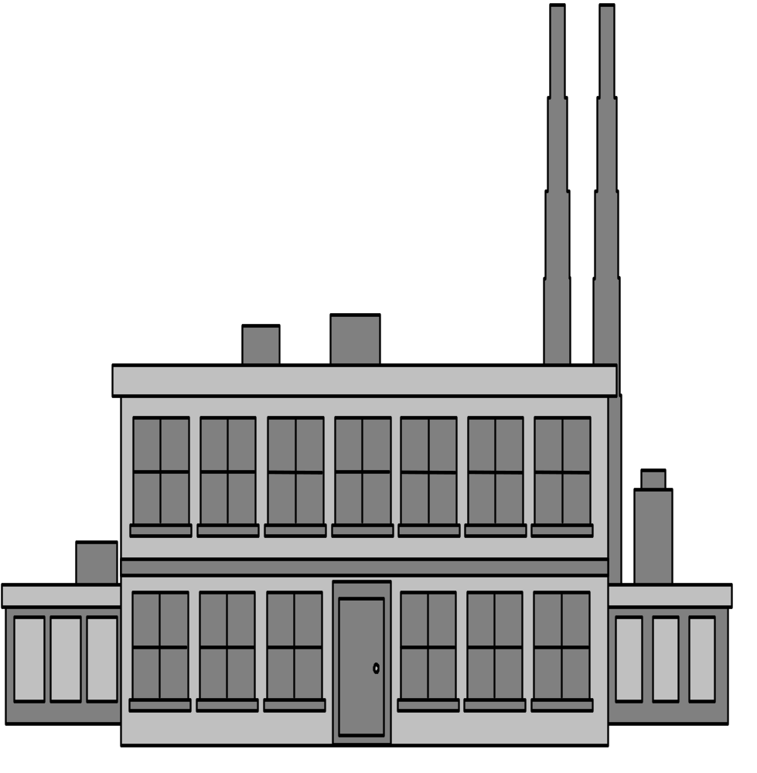

Financial Institution
retailer / manufacturer
internet
consumer

Slide 27
Business-to-Consumer
(B2C)
Basic Forms
of
Electronic
Commerce
Business-to-Business
(B2B)

Slide 28
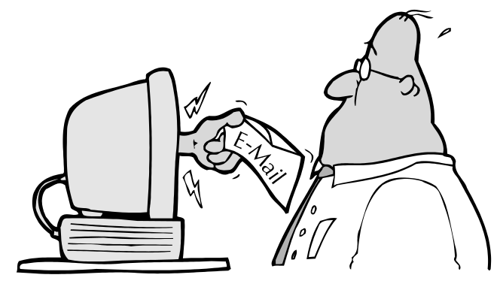
The Virtual Community
Bulletin Boards
Types of
Virtual
Communities
Chat Rooms
Newsletters
Discussion Lists

Slide 29
Selected Implications for Individual Behavior
Motivation
  Cyberloafing: using the organization’s Internet access for personal and nonjob-related surfing.
Ethics
  The dilemma of electronic surveillance of employees and employee privacy rights is exacerbated by the increasingly blurring line between work and nonwork time for employees.

Slide 30
Selected Implications for Group Behavior
Decision Making
  Individual decision making models will become increasingly obsolete in team-based e-organizations.
  Group decision making models will have greater relevance in e-organizations.
  Success e-organizations will replace rational decision making models with action models that:
    Utilize trial and error.
    Gather and assimilate data quickly.
    Accept failure and learn from it.

Slide 31
Selected Implications for Group Behavior (cont’d)
Communication
  Traditional hierarchical levels will no longer constrain communication to formal organization channels.
  Virtual meetings will allow widely dispersed employees to communicate more frequently.
  Open communications can create information overload.
Politics and Networking
  The normal face-to-face activities of effective politicians (e.g., impression management) will be supplemented by cyber-schmoozing.

Slide 32
Work Space Design
Size
  The trend is away from traditional allocation of space based on organizational statue towards a flexible open space design that accommodates group and team activities.
Arrangement
  Open arrangements foster social interaction and influence the formality of relationships
Privacy
  Individual employee needs for workplace privacy are largely a function of the type of work that the employee does (e.g., programmers, HR managers, receptionists).

Slide 33
Work Space Design (cont’d)
Feng Shui
  Designing work surroundings so the “Chi” or life force of the space is in harmony and balance with nature. (Office location and layout, Desk position, Water, Plants and flowers, Reflection)
Workspace Design and Productivity
  Workspaces alone don’t provide substantial motivation.
  Workspaces make it easier for employees to perform behaviors that make them more effective.

Slide 34
Work Redesign Options
Job Rotation: The periodic shifting of a worker from one task to another.
Job Enlargement: The horizontal expansion of jobs.
Job Enrichment: The vertical expansion of jobs.

Slide 35
Work Redesign Options (cont’d)
Team-Based Work Designs Revisited
  The Job Characteristics Model (JCM) predicts high performance of groups when:
    Group members use a variety of high level skills.
    Outcomes of the group’s work has significant consequences for other people.
    The group has substantial autonomy in deciding how they do the work.
    Work on the task generates regular, trustworthy feedback.

Slide 36
Work Schedule Options
Flextime: Employees work during a common core time period each day but have discretion in forming their total workday from a flexible set of hours outside the core.
Job Sharing: The practice of having two or more people split a 40-hour-a-week job.
Telecommuting: Employees do their work at home on a computer that is linked to their office.

Slide 37
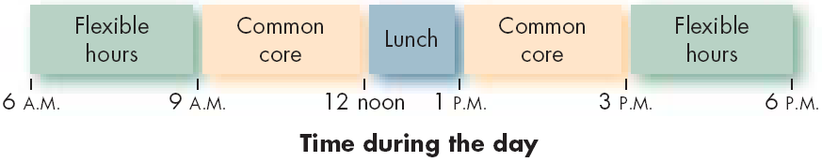
Example of a Flextime Schedule

Slide 38
Telecommuting
Advantages
  Larger labor pool
  Higher productivity
  Less turnover
  Improved morale
  Reduced office-space costs
Disadvantages (Employer)
  Less direct supervision of employees
  Difficult to coordinate teamwork
  Difficult to evaluate non-quantitative performance

Slide 39

Let’s stop it here

Slide 40
Summary

Slide 41
Elements of the Environment
Technology
Political/Legal
The Organization
Sociocultural
Economic

Slide 42
Work Design and Technology

Slide 43
Technology in the Workplace
Continuous Improvement Processes
  Good isn’t good enough
  Focus is on constantly reducing the variability in the organizational processes to produce more uniform products and services.
    Lowers costs and raises quality.
    Increases customer satisfaction.
  Organizational impact
    Additional stress on employees to constantly excel.
    Requires constant change in organization.

Slide 44
Process Reengineering
Rethinking and redesigning the processes by which the organization creates value and does work, ridding itself of operations that have become antiquated.

Slide 45
What’s an e-Organization?
A profit or nonprofit organization that uses the Internet and private network links to facilitate activities and communication

Slide 46
Work Redesign Options
Job Rotation: The periodic shifting of a worker from one task to another.
Job Enlargement: The horizontal expansion of jobs.
Job Enrichment: The vertical expansion of jobs.

Slide 47
Work Schedule Options
Flextime: Employees work during a common core time period each day but have discretion in forming their total workday from a flexible set of hours outside the core.
Job Sharing: The practice of having two or more people split a 40-hour-a-week job.
Telecommuting: Employees do their work at home on a computer that is linked to their office.

Slide 48
Next….

Slide 49
Human Resource Policies and Practices

Slide 50
Organizational Behavior
(MGT-502)
Lecture-32

